Slide 1
Internship Week 4
Samarth Sharma

Slide 2
MUSIC theory

Slide 3
Received signal:
A complex vector of N packets
Make subpackets from A of length L
subpacket1
subpacket2
X = N-L+1 subarrays each of length L
subpacket3
subpacket4
Perform Autocorrelation on each subarray. This gives Hermitian matrices of size LxL for each subarray
Take the avg of all these Hermitian matrices. Resultant is the avg autocorrelation matrix of size (LxL): C

Slide 4
Perform QR decomposition on C. Givens Rotation method is used
Init Q=I, R=C -> Iterate through columns of R. For each col j, zero the subdiagonal elements (r_ij, i>j) by multiplying the Given Rotation matrix G(i,j,θ). G(i,j,θ) is a modified identity matrix where the (i,i)th, (i,j)th, (j,i)th and (j,j)th elements are cosθ, -sinθ, sinθ, cosθ respectively, where θ is chosen such that
[ cosθ -sinθ * [a = [r
sinθ cosθ] b] 0], here r = √ (a^2 + b^2), cosθ = a/r and sinθ=-b/r
After rotation update Q and R. Repeat till R is an upper triangular matrix. All rotation matrices are orthogonal by design. G1G2….GnC = R, premultiply appropriately-> C = Gn’Gn-1’......G1’R, where the yellow matrices can be multiplied to obtain Q(an orthogonal matrix). (‘=transpose)
Now the diagonal elements of R are the eigenvalues of C. If we have T targets, the first T eigenvalues arranged in descending order correspond to the signal and others to white noise. These eigenvalues will be large in value as compared to the white noise eigenvalues.

Slide 5
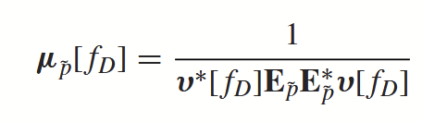

The column vectors of Q correspond to the eigenvectors. Remove the eigenvectors corresponding to the signal from Q to obtain the noise subspace (L x L-T matrix) E.
MUSIC Spectrum Generation:
Here, v[fd] is the pseudo-Doppler vector, where we have computed the values for all Doppler frequencies in our search range. When the correct Doppler frequency is reached, the denominator quickly tends to zero since the pseudo-Doppler vector becomes nearly orthogonal to the Noise Subspace (because the pseudo-Doppler vector must lie entirely in the signal subspace), giving a peak in the MUSIC spectrum. By finding these peaks, we can obtain the correct doppler frequencies.
v[f_d] =
w=2πf_d * T_PRI

Slide 6
MUSIC Results on the board

Slide 7
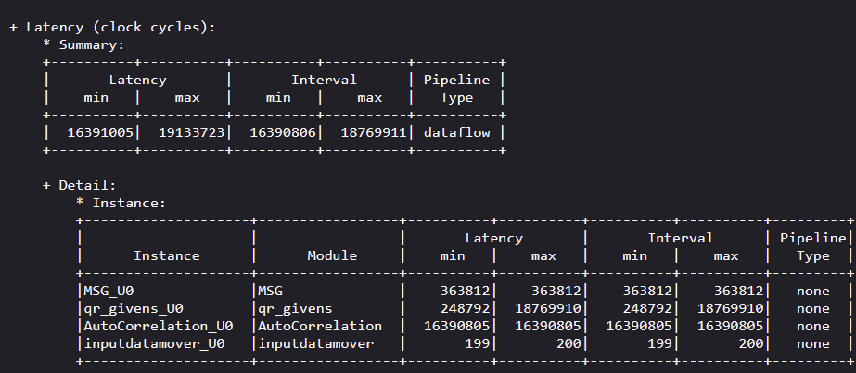
HLS 2019.1 - No automatic pipelining

Slide 8
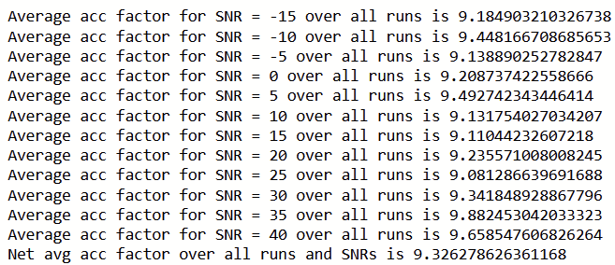


Slide 9
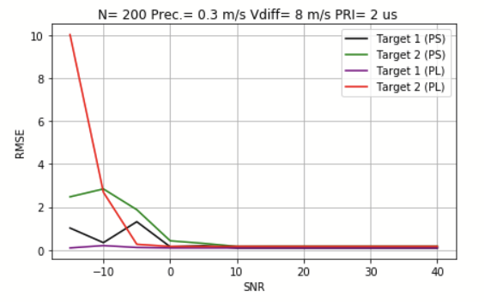
For 5 runs
5
4

Slide 10
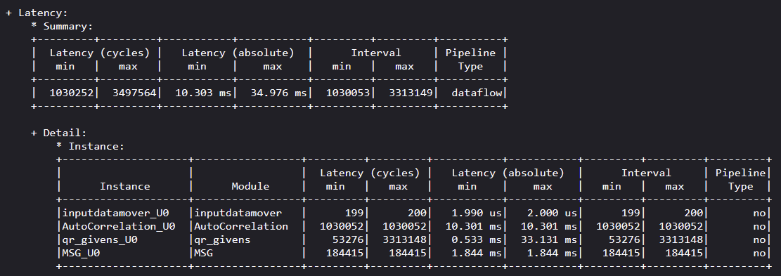
2. Vitis 2024.2 Implementation

Slide 11
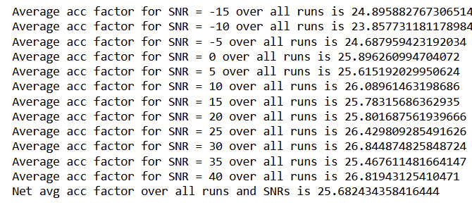


Slide 12
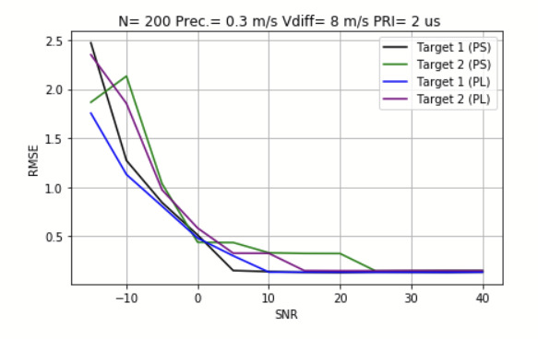
For 200 runs
4

Slide 13
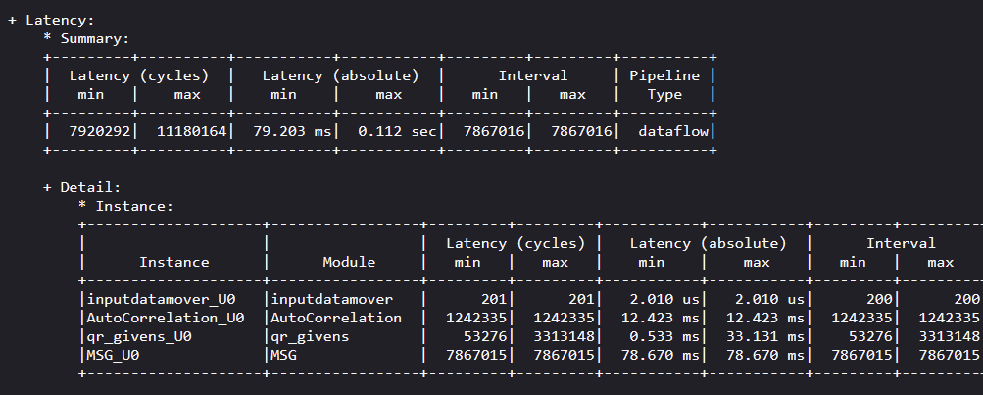
3. Removing array partitioning and pipeline from MSG (MatMul2)

Slide 14
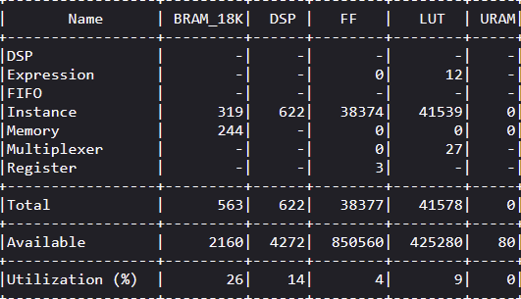
Total Resources

Slide 15
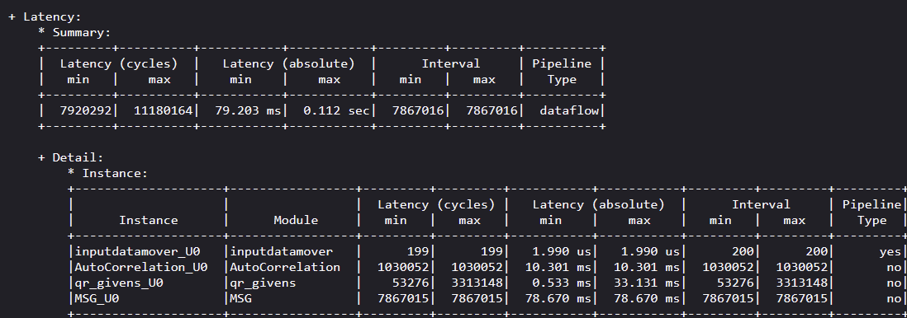
4. Unrolling the AutoCorrelation loop and pipelining input_data_mover

Slide 16
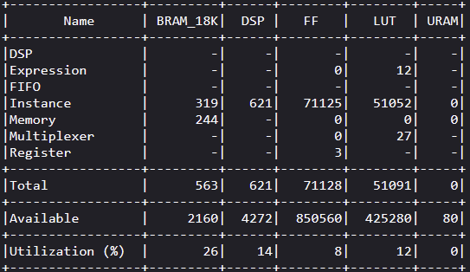
Total Resources

Slide 17
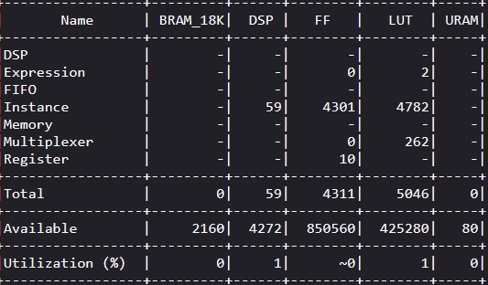
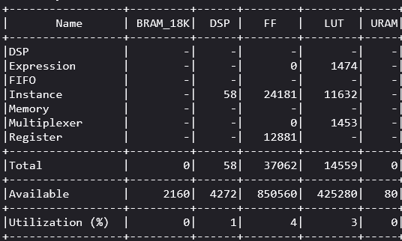
Autocorrelation Resources
UNROLL
Inputdatamover- similar resources before and after pipelining

Slide 18
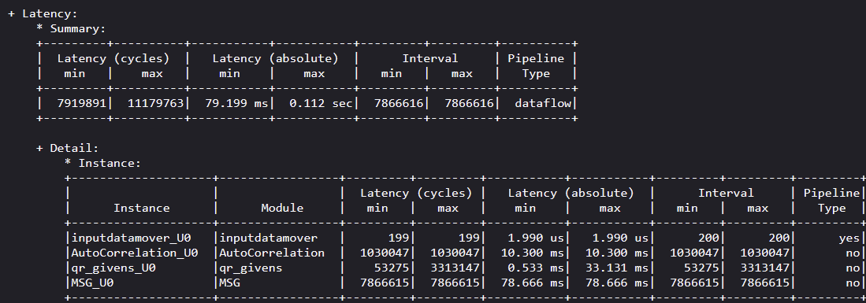
5. Applying array partitioning to AutoCorrelation, matmul2, MalM (complete) with AutoCorrelation unroll

Slide 19
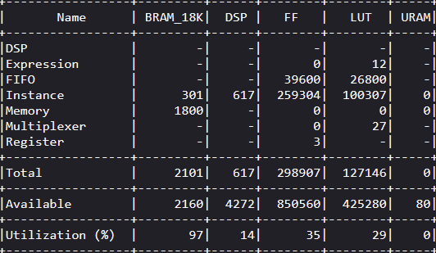

Slide 20
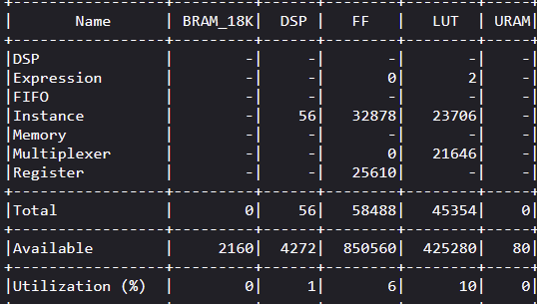
Auto-correlation resources
Array
Partitioning

Slide 21
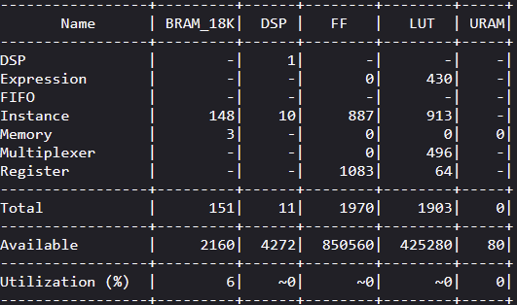
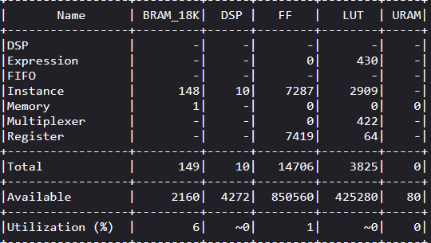
MSG resources
Array
Partitioning

Slide 22
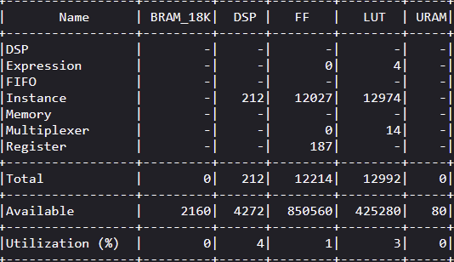
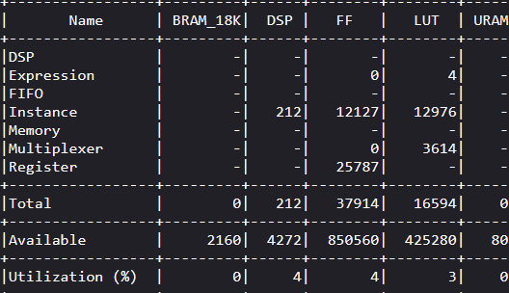
MalM resources
Array
Partitioning

Slide 23
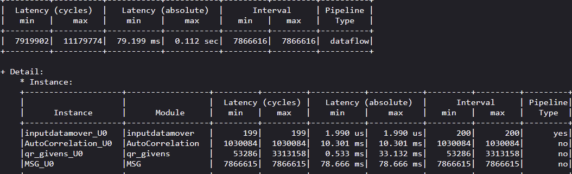
6. Changing autocorrelation to partial array partitioning (factor = 4)

Slide 24
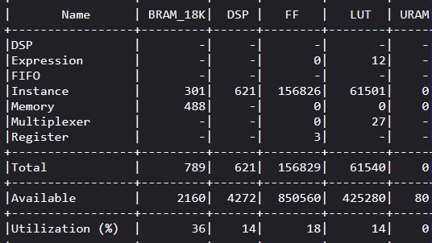

Slide 25
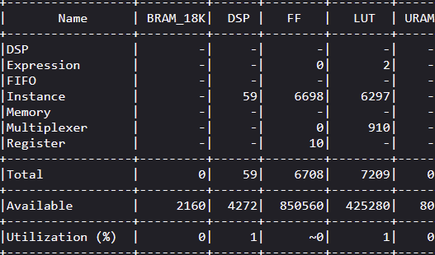
Auto-correlation resources
Partial Array
Partitioning

Slide 26
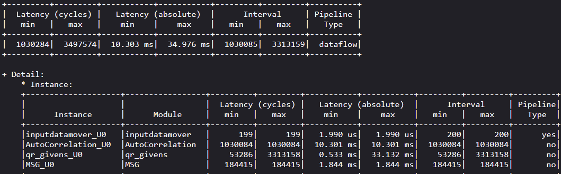
7. Adding pipelining to MSG(matmul2) with array partitioning and unroll

Slide 27
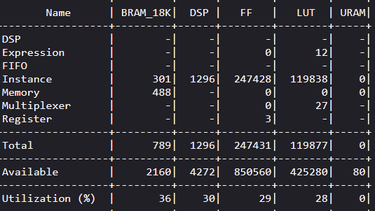
Total Resources

Slide 28
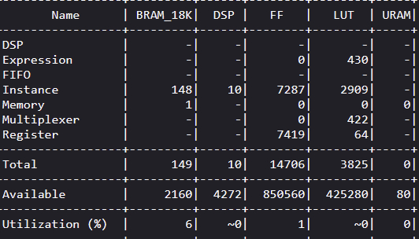
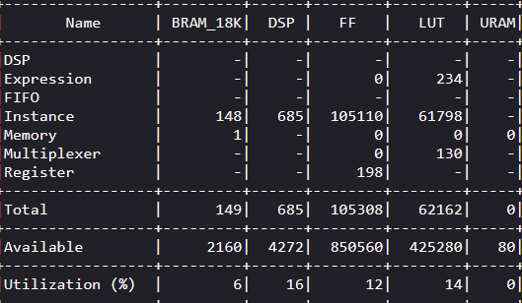
MSG resources
Pipeline

Slide 29
S.no | Optimization/Version | BRAM(%) | DSP(%) | FF(%) | LUT(%) | Total Latency (clock cycles)
1 | HLS 2019.1 | 33 | 25 | 15 | 27 | 1.91 cr
2 | Vitis 2024.2 | 31 | 30 | 16 | 23 | 35 lakh
3 | Removing Array part. from all loops and pipeline from MSG | 26 | 14 | 4 | 9 | 1.118 cr (Autocorrelation loop: 12.4 lakh) - UNOPTIMIZED
4 | Unrolling the AutoCorrelation loop | 26 | 14 | 18 | 12 | 1.118 cr (Autocorrelation loop: 10.3 lakh, MSG: 78.7 lakh)
5 | Complete Array partitioning to AutoCorrelation, matmul2, MalM with AutoCorrelation unroll | 97 | 14 | 35 | 29 | 1.1179 cr
6 | Partial Array partitioning to AutoCorrelation with previous optimizations | 36 | 14 | 18 | 14 | 1.1179 cr
7 | Pipelining MSG with array partitioning and unroll | 36 | 30 | 29 | 28 | 34.97 lakh - OPTIMIZED

Slide 30
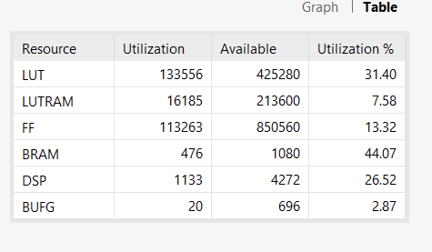
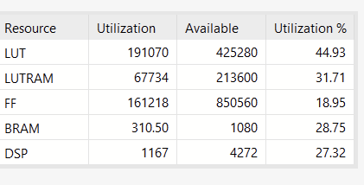
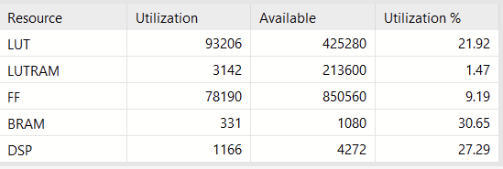
Vivado resources
2019
2024 (orignal)
Unoptimized
Optimized

Slide 31
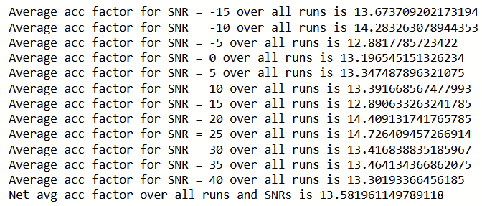
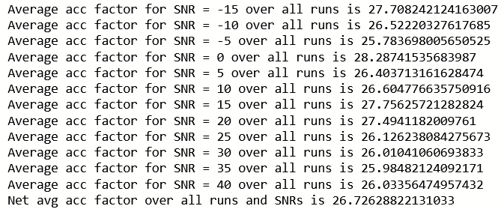


Implementation on board
Unoptimized
Optimized

Slide 32
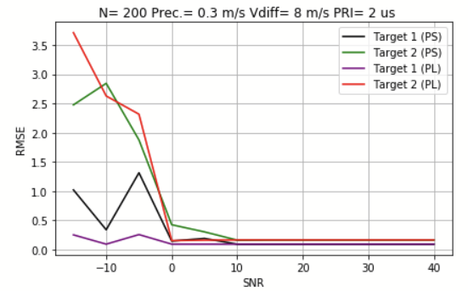
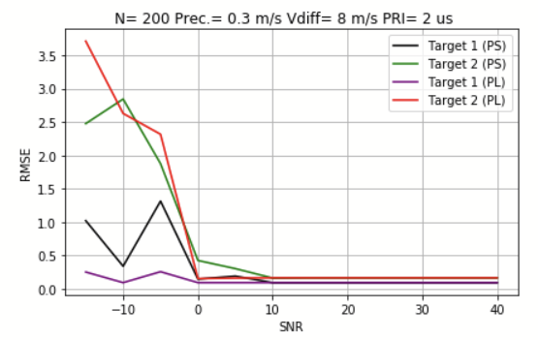
RMSE for 5 runs
Unoptimized
Optimized
5
4
5
4

Slide 33
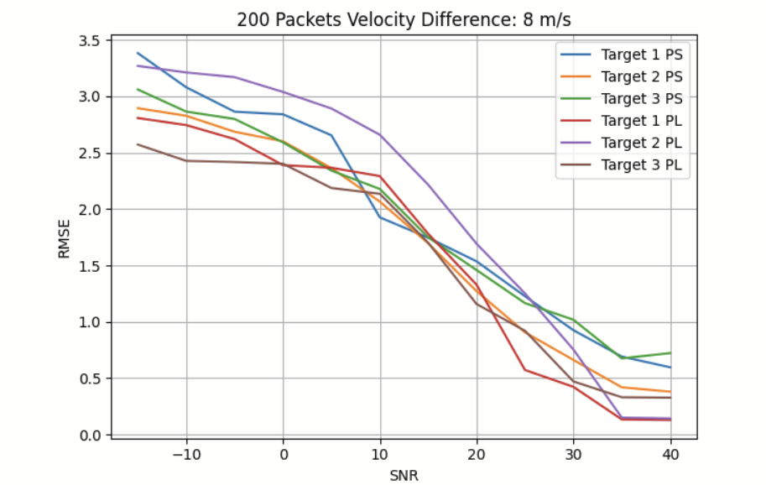


3 targets - for 200 runs
4m/s

Slide 34
Thank you!

